Slide 1
DATA QUALITY
ISSUES
Data quality and errors – Sources of error in GIS – Finding and modeling errors of GIS – Managing GIS error

Slide 2
Errors in source data for GIS
Cartographic data sources error are:
  CONTINUOUS DATA
  FUZZY BOUNDARIES
  MAP SCALE
  MAP MEASUREMENTS

Slide 3
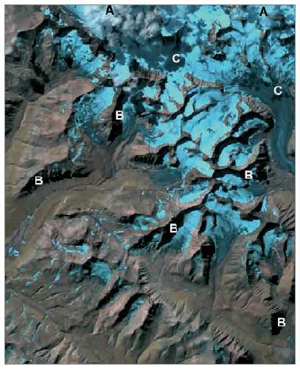
Errors in source data for GIS
Problems with remotely sensed imagery.
Satellite image with cloud cover (A);
Shadows from topography (B);
Shadows from cloud cover (C)

Slide 4
Errors in data encoding
Data encoding is the process by which data are transferred from some non-GIS source.

Slide 5
Errors in data encoding
Two main types:
source map error and
operational error.
Categorizes human digitizing error into two types:
  Psychological and
  Physiological.

Slide 6
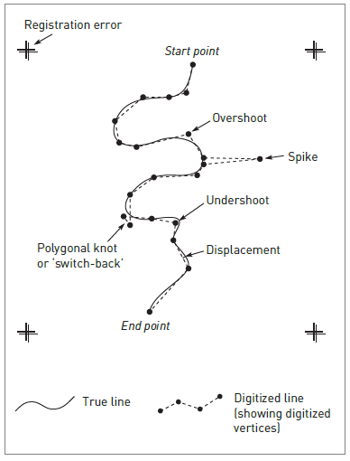
Operational errors

Slide 7
Operational errors
1 Psychological errors
2 Physiological errors
3 Line thickness.
4 Method of digitizing.
Two methods :
  point mode and
  stream mode.

Slide 8
Errors in data editing and conversion
After data encoding is complete, cleaning and editing the data are used for analysis.
GIS which can lead to unexpected results.

Slide 9
Errors in data editing and conversion
Vector GIS to check and build topology.
The closing of ‘open’ polygons and
The removal of ‘dangling’ lines
(over overshoots).

Slide 10
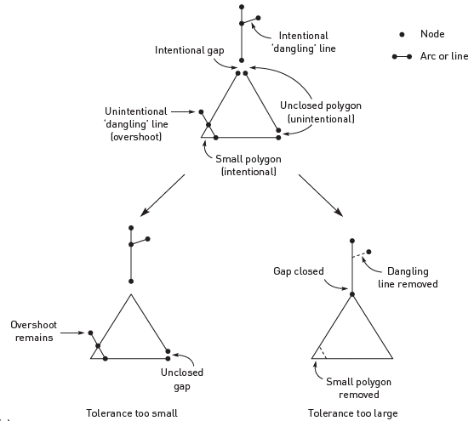
Topological errors in vector GIS
Effects of tolerances on topological cleaning

Slide 11
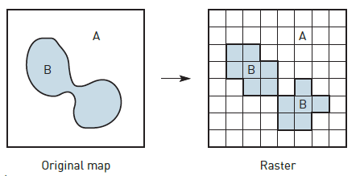
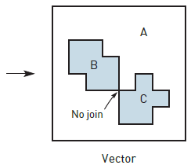
Topological ambiguities in raster to vector conversion

Slide 12
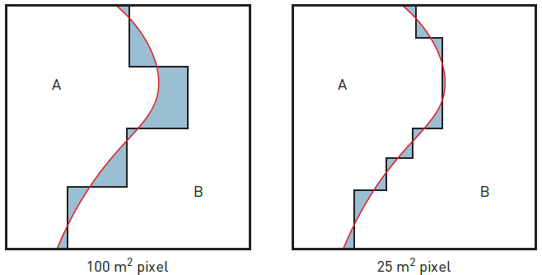
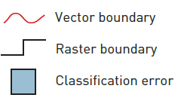
Vector to raster classification error

Slide 13
Rasterization errors
Vector to raster conversion.
For example:
1 Topological errors.
2 Loss of small polygons.
3 Effects of grid orientation.
4 Variations in grid origin and datum.

Slide 14
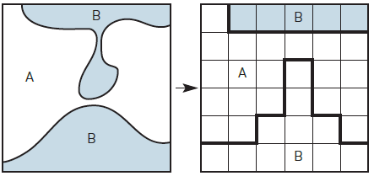
Loss of connectivity and creation of false connectivity

Slide 15
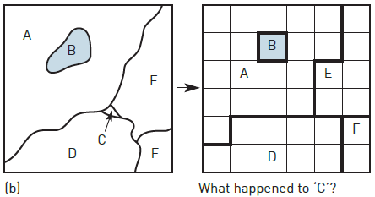
Loss of Information

Slide 16
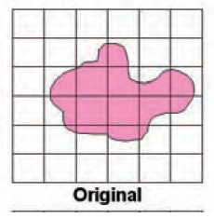
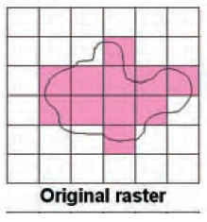
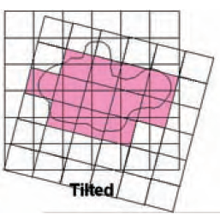
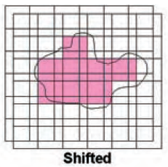
Effect of grid orientation
Effect of grid orientation and origin on rasterization

Slide 17
Errors in data processing and analysis
Errors may be introduced during the manipulation and analysis of the GIS database.
For example: Are the data suitable for this analysis? Are they in a suitable format? Are the data sets compatible?
Are the data relevant? Will the output mean anything? Is the proposed technique appropriate to the desired output?

Slide 18
Errors in data processing and analysis
Classification errors also affect raster data.
Classified satellite images provide a reflectance value
Raster maps of environmental variables, present the reflectance values.

Slide 19
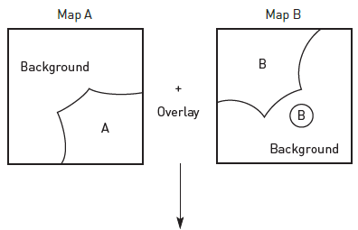
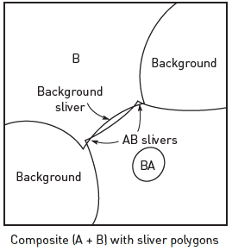
Generation of sliver polygons

Slide 20
Errors in data output
During manipulation and analysis of the data, error will result.
The inaccuracies will depend on the care and attention.
It is also possible that errors can be introduced when generalize data for the sake of clarity.

Slide 21
FINDING AND MODELLING ERRORS IN GIS
Research effort has focused on identifying, tracking and reducing error.
Keeping awareness of the general error problem.
Methods for detecting and modelling errors.
Visual inspection, double digitizing, the examination of error signatures and statistical analysis.

Slide 22
Checking for errors
Checking for data errors is by visual inspection.
Data cleaning and editing process.
Digitizing process
Double digitizing is an error-checking method
Various statistical methods can be employed

Slide 23
Error modelling
Two such methods are:
Epsilon modelling and
Monte Carlo simulation.
Epsilon modelling is based on line generalization
A Monte Carlo simulation approach has been used to model the effects of error
Statistical analysis of error and uncertainty based on re-sampling data based on random models
Combinatory models such as sieve mapping

Slide 24
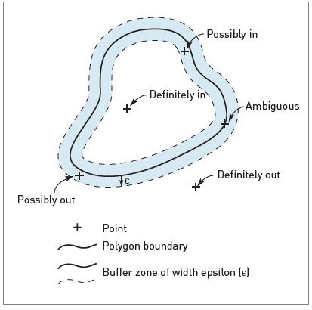
Error modelling
Point-in-polygon categories of
containment

Slide 25
MANAGING GIS ERROR
To manage these errors we must track and document them.
The data quality parameters such as – accuracy, precision, resolution, generalization, applicability, bias, compatibility, completeness and consistency.
Data quality information is used to construct a data lineage.

Slide 26
MANAGING GIS ERROR
Creation, processing and use of digital map data have attempted formalization.
Basic lineage requirements such as:
Description of source data.
Transformation documentation.
Input/output specifications.
Application-dependent information.

Slide 27
Benefits of lineage in quality control
Error detection: helps recreate analysis processes
Management accountability: accounting can be undertaken
External accountability: records the work
Quality reporting:

